Slide 1

CS-130
Legal Issues in Computing -
Software and IP

Slide 2

Learning Goals
How do major intellectual property laws interact with computer software
What is the Open Source movement and how does it impact upon software development and business models?
What are licencing agreements
Notes:
Tran – violating this requires some form of eavesdropping…..

Slide 3
Digital Technology and IP Issues
Physical goods no longer primary “things of value” in the digital media world or the “Information Age” so old laws are hard to apply
Digital technology is infinitely copy-able without degradation and easily distributable
The speed of change in the field is incredible compared to when laws were first made

Slide 4
Modern Patent Systems
Invention must be novel and non-obvious. Demonstrate a working prototype and lodge a description
In exchange for the publication of the system, you receive a monopoly on the use in exchange of usually about 20 years.
Improvement Patents
Holder cannot sell improved device without original patent holder’s permission
Original holder cannot sell improved device without improvement patent holder’s permission.
Patent holder under no obligation to grant any licence
Even if they don’t use it themselves

Slide 5
Technology and the Term of a Patent
The original Term of Monopoly for a patent (how long it lasts) was 14 years so the Internet has been in existence for only two patent lifetimes
But the World Wide Web has ben here less than one….
VisiCalc – first spreadsheet software
If it had been patented would only have dropped its patent in 1999
Enhancement patents would still be in force.
New methods and technologies still developed at increasing speeds
In this environment, the question is if a 25 ort even 20 year Patent is useful

Slide 6
Software Patents
Software was originally embedded in computers – it wasn’t so “soft”
Costs of software trivial compared with cost of machine and so became regarded as part of the machine
Viewed as provided by manufacturers to sell their machines
Key debates around software patenting
Obviousness and inventiveness – what if someone patents the for loop?
Overlap with copyright – code is already protected from direct copying
Interoperability – why doesn’t everyone use GIF or PNG?
Patent trolling – companies that only buy patents in the United States to sue other companies

Slide 7
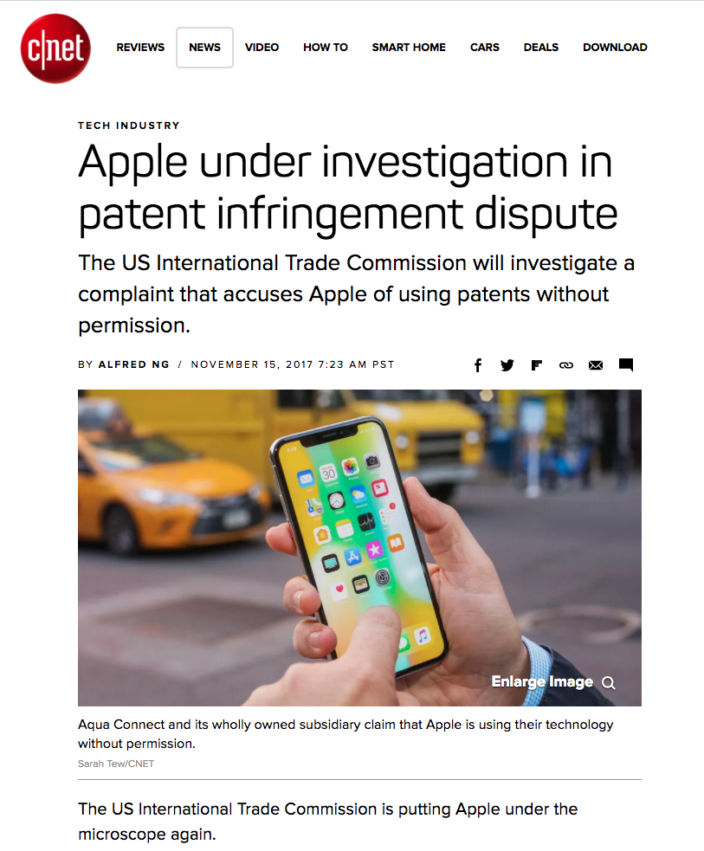

Slide 8
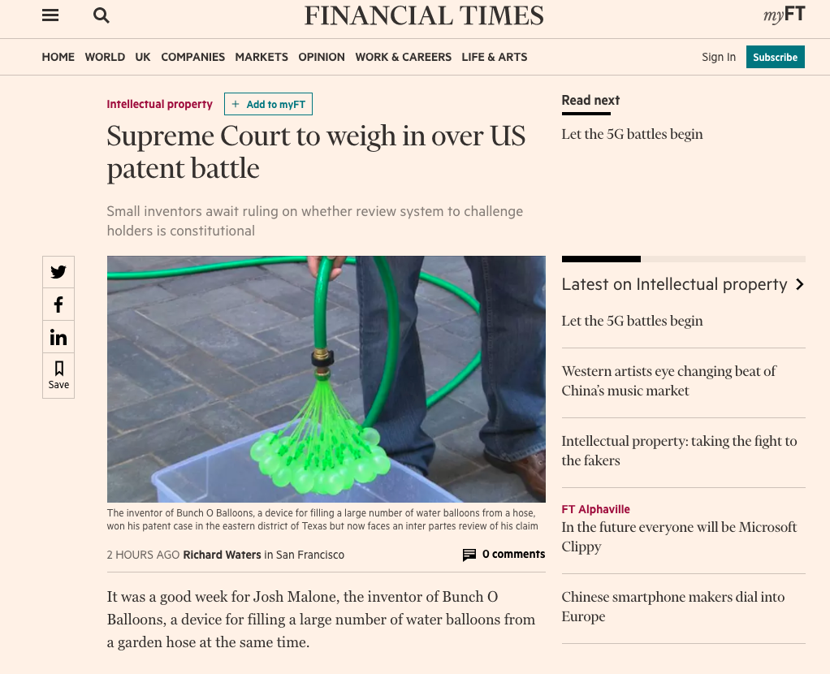

Slide 9
Detractors of IP law
“He who receives an idea from me, receives instruction himself without lessening mine; as he who lights a taper at mine, receives light without darkening me”
– Thomas Jefferson 1813.

Slide 10
Who Do IP Laws Protect/benefit?
Artist George Michael compared his record contract with Sony to slavery
Janis Ian says she would rather get $2 each DVD by selling thousands directly herself, than get $0.05 per CD on a recording contract
In contrast, CryTek, makers of the Crysis games said at one point pirated copies of Crysis outnumbered legitimate copies 15 to 1
The cost to the economy of Piracy is extremely hard to pin down
Sone argue there is no cost – why?
The rise in popularity of “Digital Platforms” is in no small part because it can be harder to pirate material on them

Slide 11
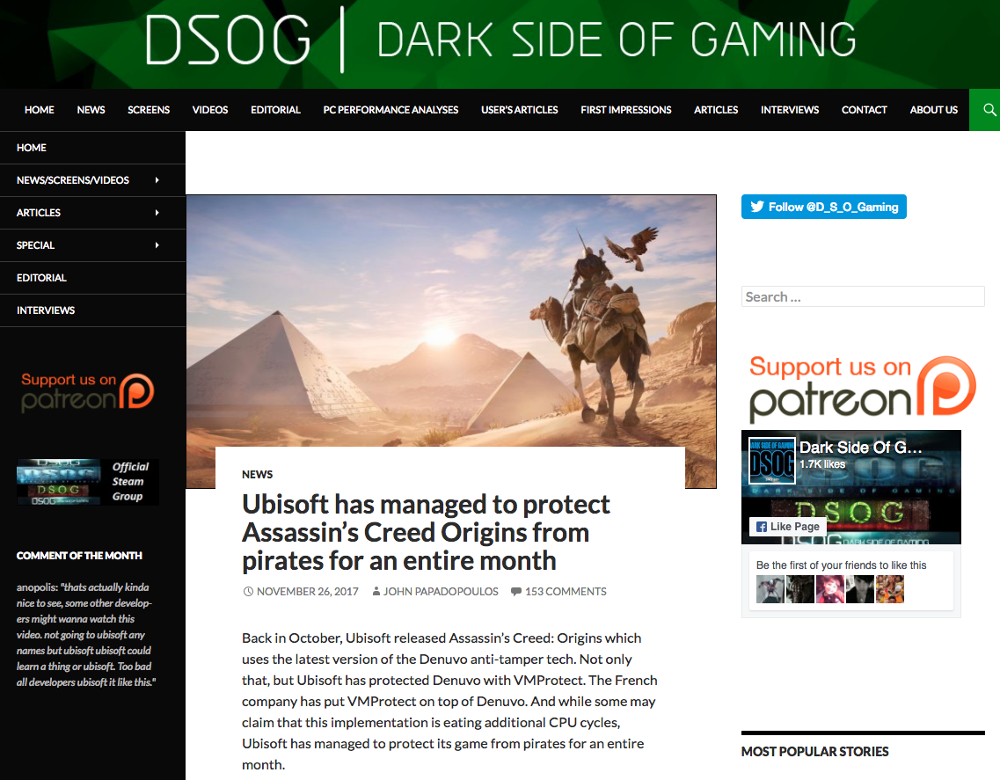

Slide 12
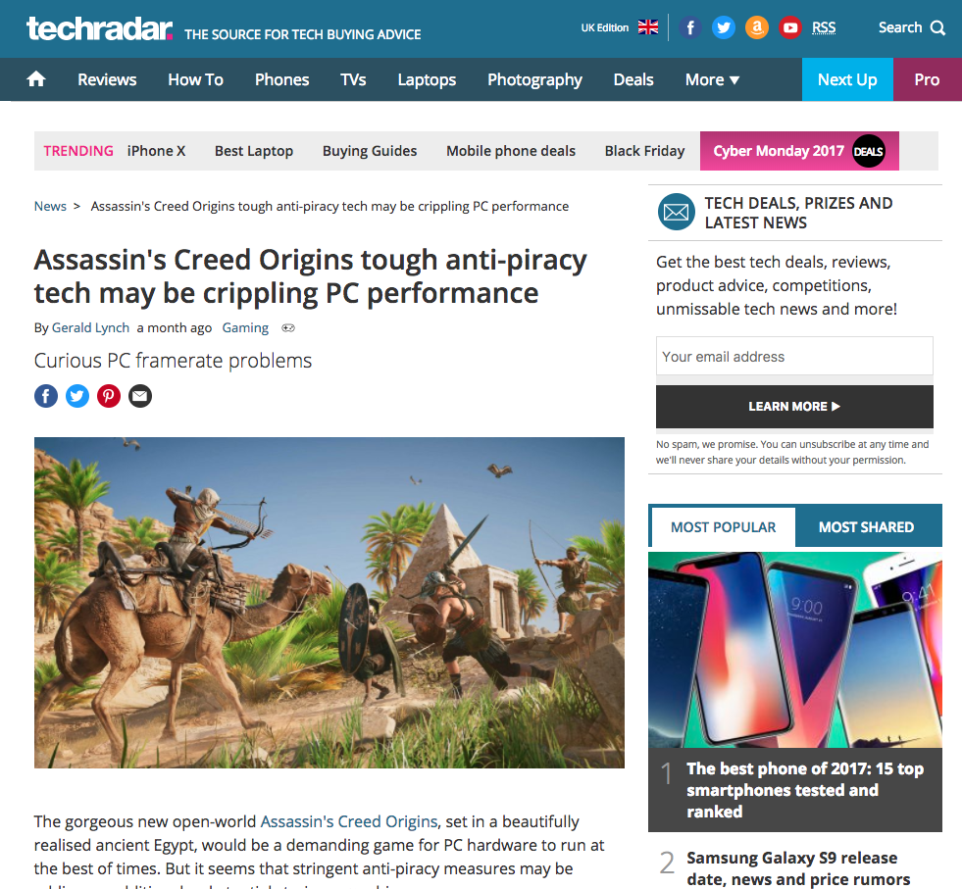

Slide 13









Prominent computing companies involved in antitrust lawsuits

Slide 14
Prominent computing companies not involved
in antitrust lawsuits

Slide 15
To what extent should you be able to patent software?

Slide 16
The Open Source Movement
Gratis vs Libre: “Free as in free speech, not as in free beer”
Open Source technologies are available under a license that requires only that you make improvements to that technology freely available
Linux, Apache Foundation and Web Server, Mozilla, Chromium, Libre Office, Android
Open Standards – HTTP, UML, PNG, PDF
Not just about software too
Open Hardware – Arduino platform you may use
And more – Open Medicine, Open Content, Open Beer(!)

Slide 17
The Open Source Movement
However, Open Source is not about giving thigs away for free and doing charitable work!
Companies need to be able to make money from their ideas if they are to be supported, so why would you give away the software for free?
Others can use your platform more easily
They even improve it and have to release those improvements (the best encryption is Open Source encryption)
Hobbyists and educators use your platform and then turn to it
As a result, your platform spreads more rapidly than the competition
You then sell support and expertise with the software in the hopes it becomes the best in the field!

Slide 18
Licensing
If you want to use other people software you need to buy it, or licence it from them
If you want to release your own work you should consider the licence you use
This is a challenge if you want to start up a small company sometimes
Software licences can be costly, typically paid out on a per-user basis
But there are consequences if you don’t pay for it and get caught
Free software licences are not the same as Open Source licences
Some limit the item to academic or personal use (why?)
Others can require a share of financial rewards

Slide 19
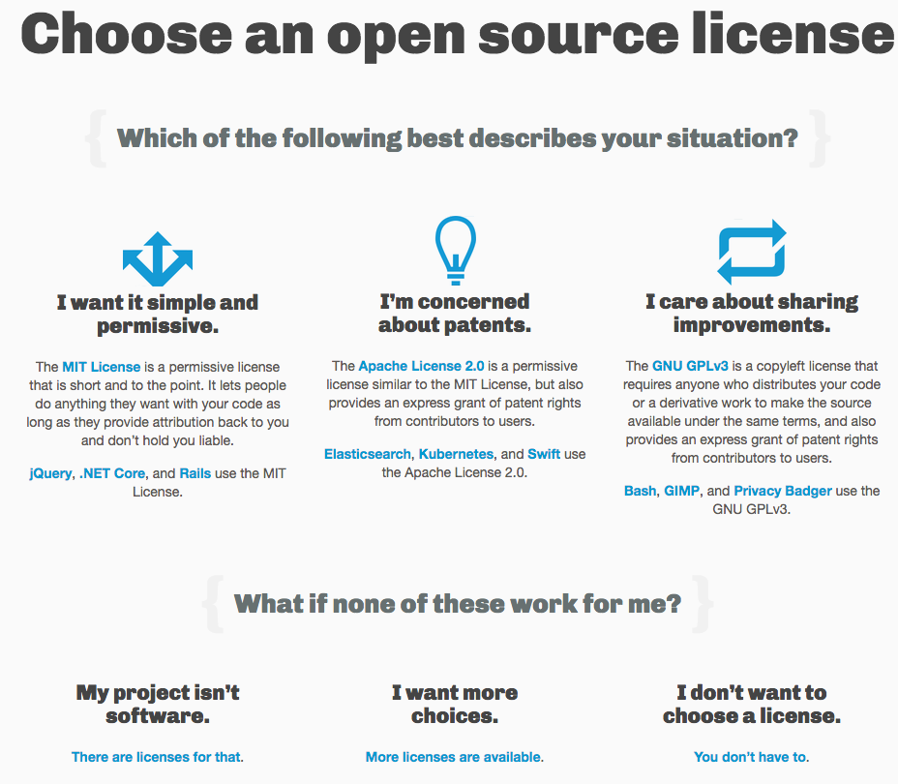

Slide 20
Learning Goals
What is Intellectual Property?
Laws about the ownership of ideas
What are the major Intellectual Property laws and how do they affect computer scientists?
Copyright and Patents on Software
What is a monopoly, why don’t we want one, and when do we allow one to exist?
Single person controlling a goods sale, anti-consumer, IP law grants it as reward for innovation
Why is Intellectual Property law controversial?
Can you own an idea? Is it beneficial?
What is the Open Source movement and why is it Libre, not just Gratis?
Free software with conditions, speech, not beer
Notes:
Tran – violating this requires some form of eavesdropping…..

